Slide 1
APPLICATIONS OF MATRICES TO CRYTOGRAPHY BY GROUP 6
20BCE11081-PRANAV MORE
20BCE10956- ANIWESH KUMAR
20BCE10910-MUSKAN JAIN
20BCE10818 - AARYAN GUPTA
20BCE10943-ROHIT TIWARY
20BCE10935- AKHIL
20BCE10892- DEEPANSHU
20BCE10999- SEELAM NAGI

Slide 2
INDEX
INTRODUCTION TO CRYPTOGRAPHY
USES OF MATRICES IN CRYPTOGRAPHY
APPLICATIONS OF MATRICES
ENCODING
DENCODING
INVERSE OF MATRIX
HILL CIPHER
EXAMPLES
ACKNOWLEDGEMENT

Slide 3
INTRODUCTION
Cryptography is an art of communication between 2 people by keeping the information not known to other ….. it is based upon 2 factor namely encryption and decryption
The key matrix is used to encrypt the message and its inverse is used to decrypt the encoded message. It is important that key matrix be kept secret between the message sender and intended reciptants . If the key matrix or its inversed is discovered ,then all intercepted message can easily be decoded .

Slide 4
Uses of matrices in cryptography
One type of code ,which is extremely difficult to break, makes use of a large matrices to encode a message
The receiver of message decodes it using the inverse of the matrix.
The 1st matrix used by the sender is called encoding matrix and inverse of it is called decoding matrix , which is used by receiver
Computer graphics: 4*4 transformation rotation matrices are commonly used in computer graphics.

Slide 5
Application Of Matrices to Cryptography
• One type of code, which is extremely difficult to break, makes use of a large matrix to encode a message.
• The receiver of the message decodes it using the inverse of the matrix.
• This first matrix, used by the sender is called the encoding matrix and its inverse is called the decoding matrix, which is used by the receiver.

Slide 6
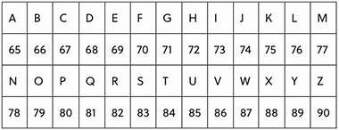
ENCODING
Encoding is the process of putting a sequence of characters such as letters, numbers and other special characters into a specialized format for efficient transmission.
There are three types of encoding namely acoustic ,tactile ,visual and symantic.
ENCODING USING MATRICES
Use matrix A=[1123]A=[1213] to
encode the message:
ATTACK NOW!

Slide 7

We divide the letters of the message into groups of two.
AT TA CK -N OW
We assign the numbers to these letters from the above table, and convert each pair of numbers into 2×1 matrices. In the case where a single letter is left over on the end, a space is added to make it into a pair.

Slide 8
DECODING
The receiver decodes the message to retrieve the original message by using the inverse of matrix.
The matrix used for decoding is called decryption or decoding matrix

Slide 9


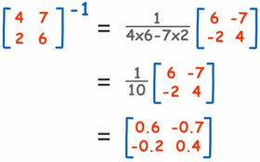
MATRIX INVERSE FORMULA

Slide 10
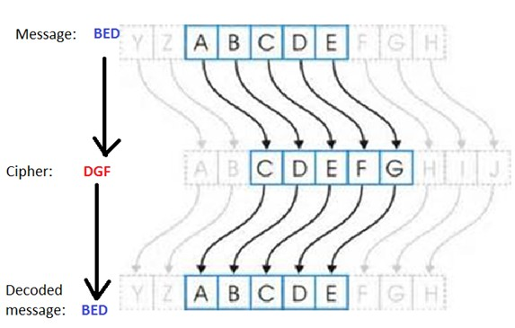
CRYPTOLOGY

Slide 11
HILL CIPHER
As time progressed, the study of cryptography began to involve higher level mathematics. With this more advanced math came more advanced ciphers based on the idea of encryption and decryption keys. Encryption keys are a special value or set of values used in an encryption algorithm to convert a plaintext into a cipher text. A decryption key is the opposite. One encryption scheme that utilizes more advanced mathematics, as well as encryption and decryption keys is a cipher from 1929 called the Hill cipher. The Hill cipher is based on matrix multiplication and is a lot more secure than the Caesar cipher that was previously discussed.

Slide 12
Encoding Hill Cipher
Convert letters into numbers
Write message into blocks (matrices) of two
Multiply decoding matrix A with the vectors
Convert numbers into letters
Decoding Hill Cipher
Convert numbers into letters
Multiply decoding matrix 𝐴 −1 with the vectors
Convert numbers into letters
Worksheet on encoding and decoding!

Slide 13
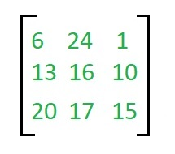

EXAMPLE
Encryption
We have to encrypt the message ‘ACT’ (n=3).The key is ‘GYBNQKURP’ which can be written as the nxn matrix:
The message ‘ACT’ is written as vector:

Slide 14
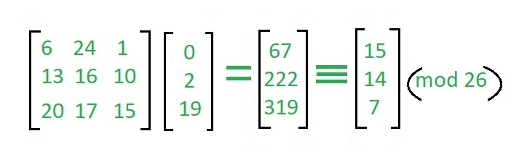
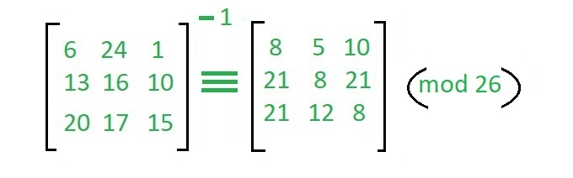
The enciphered vector is given as:
which corresponds to cipher text of ‘POH’
Decryption
To decrypt the message, we turn the ciphertext back into a vector, then simply multiply by the inverse matrix of the key matrix (IFKVIVVMI in letters).The inverse of the matrix used in the previous example is:

Slide 15
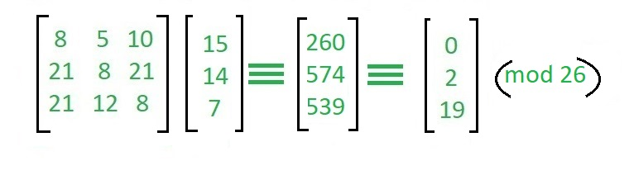
For the previous Cipher text ‘POH’:
which gives us back ‘ACT’. Assume that all the alphabets are in upper case. Below is the implementation of the above idea for n=3.

Slide 16
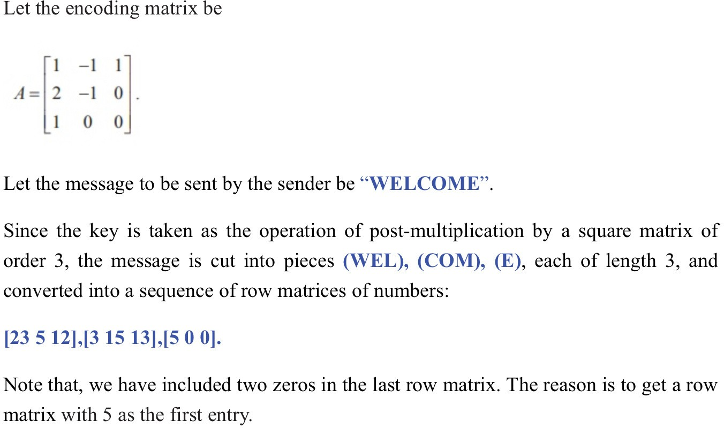
EXAMPLES

Slide 17
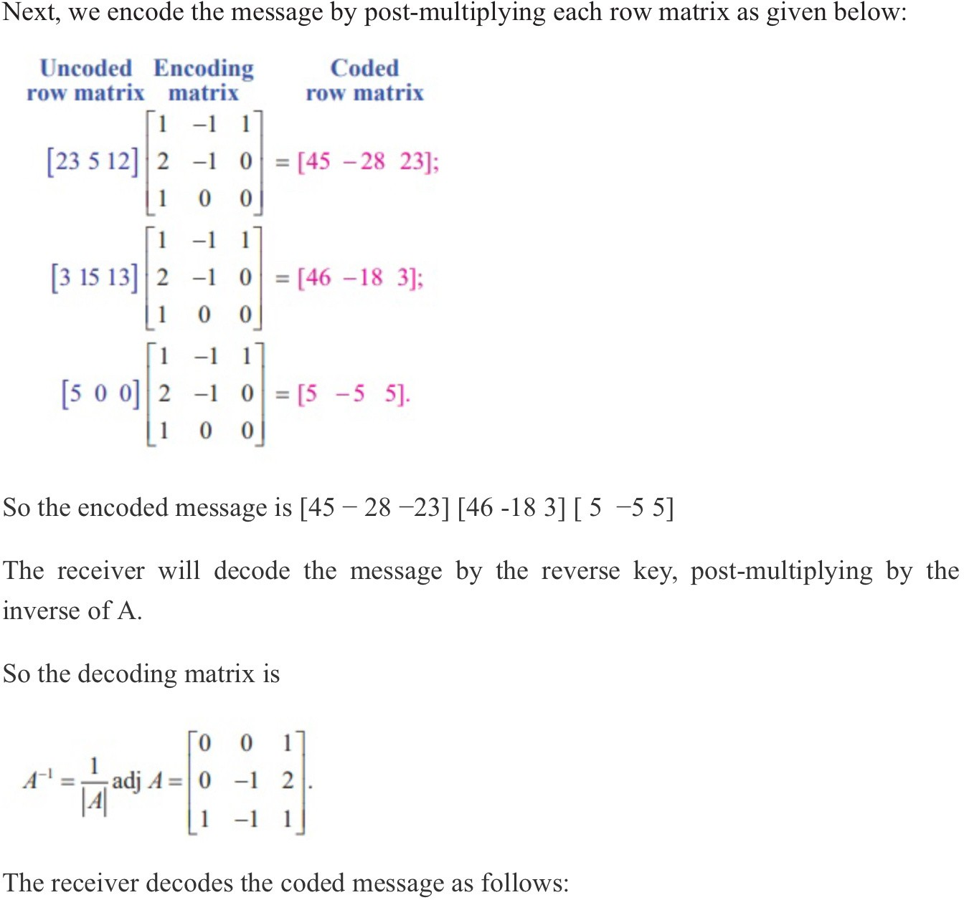

Slide 18
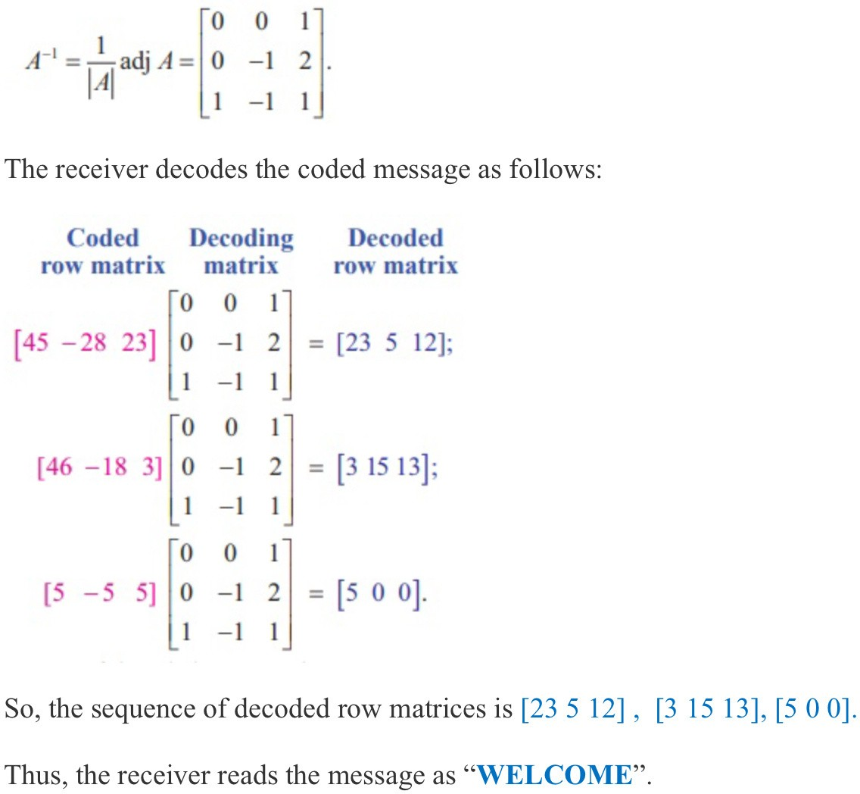

Slide 19
ACKNOWLEDGEMENT
I would like to express my special thanks of gratitude to my teacher Mayank Sharma who gave me and my team the golden opportunity to do this wonderful project on the topic application of matrices to cryptography which also helped me in doing a lot of Research and I came to know about so many new things I am really thankful to them.
Secondly I would also like to thank my parents and friends who helped me a lot in finalizing this project within the limited time frame.

Slide 20
THANK YOU !

